Slide 1
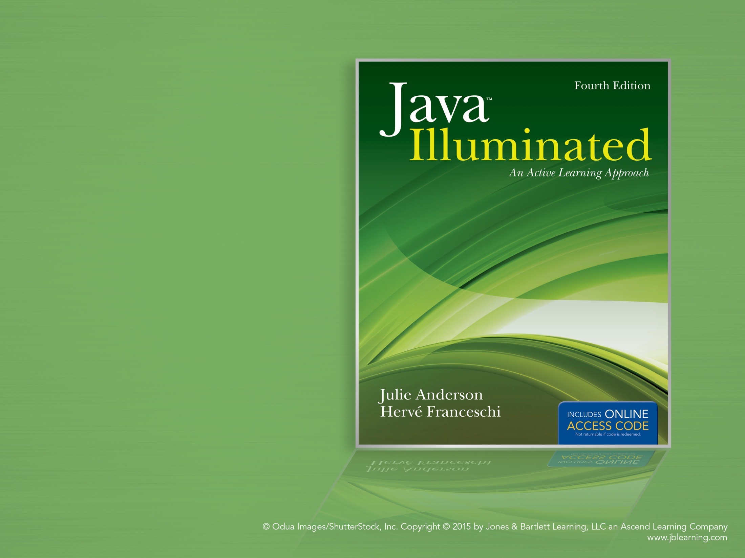
Chapter 8
Single-Dimensional Arrays

Slide 2
Topics
Declaring and Instantiating Arrays
Accessing Array Elements
Aggregate Array Operations
Using Arrays in Classes
Searching and Sorting Arrays
Using Arrays as Counters
Accepting a Variable Number of Arguments

Slide 3
Arrays
An array is a sequence of variables of the same data type.
Arrays are useful for many applications, for example, calculating statistics or representing the state of a game.
The data type can be any of Java's primitive types (int, short, byte, long, float, double, boolean, char), an array, or a class.
Each variable in the array is called an element.
We use an index to specify the position of each element in the array.

Slide 4
Declaring and Instantiating Arrays
Arrays are objects, so creating an array requires two steps:
  declaring a reference to the array
  instantiating the array
To declare a reference to the array, use this syntax:
datatype [] arrayName;
To instantiate an array, use this syntax:
arrayName = new datatype[size];
where size is an expression that evaluates
to an integer and specifies the number of
elements.

Slide 5
Examples
Declaring arrays:
double [] dailyTemps; // elements are doubles
String [] cdTracks; // elements are Strings
boolean [] answers; // elements are booleans
Auto [] cars; // elements are Auto references
int [] cs101, bio201; // two int arrays
Instantiating these arrays:
dailyTemps = new double[365]; // 365 elements
cdTracks = new String[15]; // 15 elements
int numberOfQuestions = 30;
answers = new boolean[numberOfQuestions];
cars = new Auto[3]; // 3 elements
cs101 = new int[5]; // 5 elements
bio201 = new int[4]; // 4 elements

Slide 6
Default Values for Elements
When an array is instantiated, the elements are assigned default values according to the array data type.
Array data type | Default value
byte, short, int, long | 0
float, double | 0.0
char | The null character (\u0000)
boolean | false
Any object reference (for example, a String) | null

Slide 7
Combining the Declaration and Instantiation of Arrays
Syntax:
datatype [] arrayName = new datatype[size];
Examples:
double [] dailyTemps = new double[365];
String [] cdTracks = new String[15];
int numberOfQuestions = 30;
boolean [] answers
= new boolean[numberOfQuestions];
Auto [] cars = new Auto[3];
int [] cs101 = new int[5], bio201 = new int[4];

Slide 8
Assigning Initial Values to Arrays
Arrays can be instantiated by specifying a list of initial values.
Syntax:
datatype [] arrayName = { value0, value1, … };
where valueN is an expression evaluating to
the data type of the array and is the value
to assign to the element at index N.
Examples:
int nine = 9;
int [] oddNumbers = { 1, 3, 5, 7, nine, nine + 2,
13, 15, 17, 19 };
Auto sportsCar = new Auto( "Ferrari", 0, 0.0 );
Auto [] cars = { sportsCar, new Auto( ),
new Auto("BMW", 100, 15.0 ) };

Slide 9

Common Error Trap
An initialization list can be given only when the array is declared.
  Attempting to assign values to an array using an initialization list after the array is instantiated will generate a compiler error.
The new keyword is not used when an array is instantiated using an initialization list. Also, no size is specified for the array; the number of values in the initialization list determines the size of the array.

Slide 10
Accessing Array Elements
To access an element of an array, use this syntax:
arrayName[exp]
where exp is an expression that
evaluates to an integer.
exp is the element's index — its position within the array.
The index of the first element in an array is 0.
length is a public, constant integer instance variable that holds the number of elements in the array and is accessed using this syntax:
arrayName.length

Slide 11
Common Error Trap
Attempting to access an element of an array using an index less than 0 or greater than arrayName.length - 1 will generate an ArrayIndexOutOfBoundsException at run time.
Note that for an array, length – without parentheses – is an instance variable, whereas for Strings, length( ) – with parentheses – is a method.
Note also that the array's instance variable is named length, rather than size.

Slide 12
Accessing Array Elements
See Example 8.1 CellBills.java
Element | Syntax
First element | arrayName[0]
Element i | arrayName[i]
Last element | arrayName[arrayName.length - 1]

Slide 13
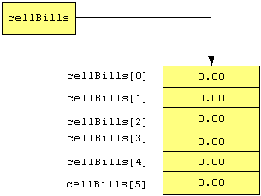
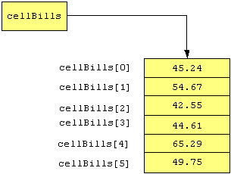
cellBills Array
When instantiated: After assigning values:

Slide 14
Instantiating an Array of Objects
To instantiate an array with a class data type:
  1. instantiate the array (elements are object references, initialized to null)
2. instantiate the objects
Example:
// instantiate array; all elements are null
Auto [] cars = new Auto[3];
// instantiate objects and assign to elements
Auto sportsCar = new Auto( "Miata", 100, 5.0 );
cars[0] = sportsCar;
cars[1] = new Auto( );
// cars[2] is still null
See Example 8.2 AutoArray.java

Slide 15
Aggregate Array Operations
We can perform the same operations on arrays as we do on a series of input values.
  calculate the total of all values
  count values meeting specified criteria
  find the average value
  find a minimum or maximum value, etc.
To perform an operation on all elements in an array, we use a for loop to perform the operation on each element in turn.

Slide 16
Standard for Loop Header for Array Operations
for ( int i = 0; i < arrayName.length; i++ )
  initialization statement ( int i = 0 ) creates index i and sets it to the first element ( 0 ).
  loop condition ( i < arrayName.length ) continues execution until the end of the array is reached.
  loop update ( i++) increments the index to the next element, so that we process each element in order.
Inside the for loop, we reference the current element as:
arrayName[i]

Slide 17
Printing All Elements of an Array
Example: This code prints each element in an array named cellBills, one element per line
(assuming that cellBills has been instantiated):
for ( int i = 0; i < cellBills.length; i++ )
{
System.out.println( cellBills[i] );
}
See Example 8.3 PrintingArrayElements.java

Slide 18
Reading Data Into an Array
Example: this code reads values from the user into an array named cellBills, which has previously been instantiated:
Scanner scan = new Scanner( System.in );
for ( int i = 0; i < cellBills.length; i++ )
{
System.out.print( "Enter bill > " );
cellBills[i] = scan.nextDouble( );
}
See Example 8.4 ReadingDataIntoAnArray.java

Slide 19
Calculating a Total
Example: this code calculates the total value of all elements in an array named cellBills, which has previously been instantiated:
double total = 0.0; // initialize total
for ( int i = 0; i < cellBills.length; i++ )
{
total += cellBills[i];
}
System.out.println( "The total is " + total );
See Example 8.5 SummingArrayElements.java

Slide 20
Finding Maximum/Minimum Values
Example: this code finds the index of the maximum value in an array named cellBills:
// make first element the current maximum
int maxIndex = 0;
// start for loop at element 1
for ( int i = 1; i < cellBills.length; i++ )
{
if ( cellBills[i] > cellBills[maxIndex] )
maxIndex = i;
}
System.out.println( "The maximum is "
+ cellBills[maxIndex] );
See Example 8.6 MaxArrayValue.java

Slide 21
Copying Arrays
Suppose we want to copy the elements of an array to another array. We could try this code:
double [] billsBackup = new double [6];
billsBackup = cellBills; // incorrect!
Although this code compiles, it is logically incorrect! We are copying the cellBills object reference to the billsBackup object reference. We are not copying the array data.
The result of this code is shown on the next slide ->

Slide 22
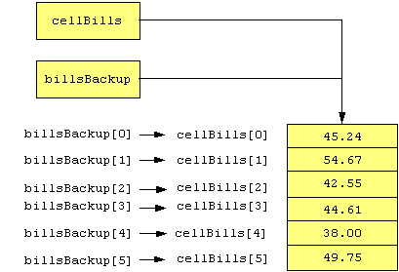
Copying Array References
billsBackup = cellBills;
has this effect. Both references point to the same array.

Slide 23
Copying Array Values
Example: this code copies the values of all elements in an array named cellBills to an array named billsBackup, both of which have previously been instantiated with the same length:
for ( int i = 0; i < cellBills.length; i++ )
{
billsBackup[i] = cellBills[i];
}
The effect of this for loop is shown on the next slide ->
See Example 8.7 CopyingArrayElements.java

Slide 24
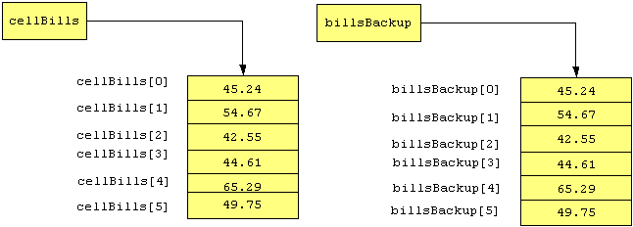
Copying Array Values
A separate copy of the array has been created.

Slide 25
Changing an Array's Size
An array's length instance variable is constant.
  that is, arrays are assigned a constant size when they are instantiated.
To expand an array while maintaining its original values:
  Instantiate an array with the new size and a
  temporary name.
  Copy the original elements to the new array.
  Point the original array reference to the new array.
  Assign a null value to the temporary array reference.

Slide 26
Expanding the Size of an Array
This code expands the size of the cellBills array from 6 elements to 12 elements:
//instantiate new array with a temporary name
double [] temp = new double [12];
// copy all elements from cellBills to temp
for ( int i = 0; i < cellBills.length; i++ )
{
temp[i] = cellBills[i]; // copy each element
}
// point cellBills to new array
cellBills = temp;
temp = null; // assign null to temp reference

Slide 27
Comparing Arrays for Equality
To compare whether the elements of two arrays are equal:
  Determine if both arrays have the same length.
  Compare each element in the first array with the corresponding element in the second array.
To do this, we'll use a flag variable and a for loop.
At the end of the code, the value of the flag variable isEqual will indicate whether the arrays are equal.

Slide 28
Comparing cellBills1 to cellBills2
boolean isEqual = true; // flag variable
if ( cellBills1.length != cellBills2.length )
isEqual = false; // sizes are different
else
{
for ( int i = 0;
i < cellBills1.length && isEqual; i++ )
{
if ( Math.abs( cellBills1[i] - cellBills2[i] )
> 0.001 )
isEqual = false; // elements are not equal
}
}
See Example 8.8 ComparingArrays.java

Slide 29
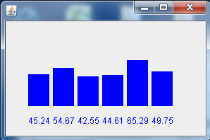
Displaying a Bar Chart
We can display the data of an array graphically as a bar chart:
Each bar is drawn as a rectangle using the fillRect method of the Graphics class.

Slide 30
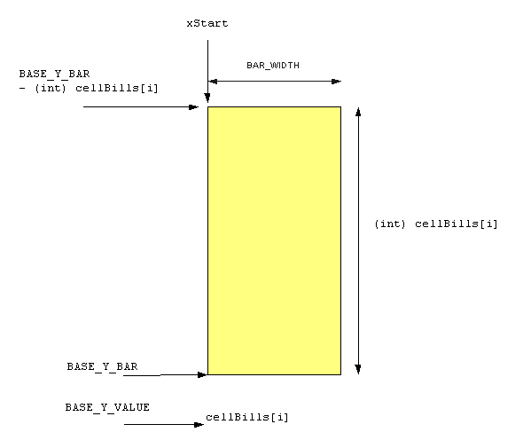
Arguments for the fillRect Method

Slide 31
Arguments for the fillRect Method
API for the fillRect method in the Graphics class:
void fillRect( int upperLeftX, int upperLeftY,
int width, int height )
width:
  the width of the bar is a constant value. For our bar chart, we chose a width of 30 pixels.
height:
  the height for each bar is the value of the array element being charted.

Slide 32
Arguments for the fillRect Method
upperLeftY value:
  the height of the bar subtracted from the base y value for drawing all the bars. We subtract because y values increase from the top of the window to the bottom.
upperLeftX value:
  the first bar starts at a constant left margin value. After we draw each bar, we position to the starting x value for the next bar by adding to the current start x value the width of the bar, plus a constant space between bars.

Slide 33
Drawing the Bar Chart
int xStart = LEFT_MARGIN; // first bar
for ( int i = 0; i < cellBills.length; i++ )
{
g.fillRect( xStart,
BASE_Y_BAR - (int)( cellBills[i] ),
BAR_WIDTH, (int)( cellBills[i] ) );
g.drawString( Double.toString( cellBills[i] ),
xStart, BASE_Y_VALUE );
// move to starting x value for next bar
xStart += BAR_WIDTH + SPACE_BETWEEN_BARS;
}
See Example 8.9 CellBillBarChart.java

Slide 34
Using Arrays in Classes
In a user-defined class, an array can be
  an instance variable
  a parameter to a method
  a return value from a method
  a local variable in a method

Slide 35
Methods with Array Parameters
To define a method that takes an array as a parameter, use this syntax:
accessModifier returnType methodName(
dataType [] arrayName )
To define a method that returns an array, use this syntax:
accessModifier dataType [] methodName(
parameterList )
To pass an array as an argument when calling a method, use the array name without brackets:
methodName( arrayName )

Slide 36
Common Error Trap
If you think of the brackets as being part of the data type of the array, then it's easy to remember that
  brackets are included in the method header (where the data types of parameters are given)
  brackets are not included in method calls (where the data itself is given).

Slide 37
Arrays as Instance Variables
Because arrays are objects, the name of an array is an object reference.
Methods must be careful not to share references to instance variables with the client. Otherwise, the client could directly change the array elements using the reference to the array instance variable.
See Example 8.11 CellPhone.java
Example 8.12 CellPhoneClient.java

Slide 38
Array Instance Variables
A constructor (or mutator) that accepts an array parameter should instantiate the instance variable array and copy the elements from the parameter array to the instance variable.
// constructor
public CellPhone( double [] bills )
{
// instantiate instance variable array
// with same length as parameter
cellBills = new double [bills.length];
// copy parameter array to cellBills array
for ( int i = 0; i < cellBills.length; i++ )
cellBills[i] = bills[i];
}

Slide 39
Accessors for Arrays
Similarly, an accessor method for the array instance variable should return a reference to a copy of the array.
public double [] getCellBills( )
{
// instantiate temporary array
double [] temp = new double [cellBills.length];
// copy instance variable values to temp
for ( int i = 0; i < cellBills.length; i++ )
temp[i] = cellBills[i];
// return copy of array
return temp;
}

Slide 40

SOFTWARE
ENGINEERING TIP
Sharing array references with the client violates encapsulation.
  To accept values for an instance variable array as a parameter to a method, instantiate the instance variable array and copy the elements of the parameter array to the instance variable.
  Similarly, to return an instance variable array, a method should copy the elements of the instance variable array to a temporary array and return a reference to the temporary array.

Slide 41
Retrieving Command Line Arguments
The syntax of an array parameter for a method might look familiar. We've seen it repeatedly in the header for the main method:
public static void main( String [] args )
main receives a String array as a parameter. That array holds the arguments, if any, that the user sends to the program from the command line.
For example, command line arguments might be:
  the name of a file for the program to use
  configuration preferences

Slide 42
Printing Command Line Arguments
public static void main( String [] args )
{
System.out.println( "The number of parameters "
+ " is " + args.length );
for ( int i = 0; i < args.length; i++ )
{
System.out.println( "args[" + i + "]: "
+ args[i] );
}
}
See Example 8.13 CommandLineArguments.java

Slide 43
Sequential Search
A Sequential Search can be used to determine if a specific value (the search key) is in an array.
Approach: start with the first element and compare each element to the search key:
  If found, return the index of the element that contains the search key.
  If not found, return -1.
    because -1 is not a valid index, this is a good return value to indicate that the search key was not found in the array.

Slide 44
Code to Perform a Sequential Search
public int indexOfWinner( int key )
{
for ( int i = 0; i < winners.length; i++ )
{
if ( winners[i] == key )
return i;
}
return -1;
}
See Example 8.14 DVDWinners.java
and Example 8.15 DVDWinnersClient.java

Slide 45
Sorting an Array
When an array's elements are in random order, our Sequential Search method needs to look at every element in the array before discovering that the search key is not in the array.
This is inefficient; the larger the array, the more inefficient a Sequential Search becomes.
We could simplify the search by arranging the elements in numeric order, which is called sorting the array. Once the array is sorted, we can use other search algorithms to speed up a search.

Slide 46
Selection Sort
In a Selection Sort, we select the largest element in the array and place it at the end of the array. Then we select the next-largest element and put it in the next-to-last position in the array, and so on.
To do this, we consider the unsorted portion of the array as a subarray.
  We repeatedly select the largest value in the current subarray and move it to the end of the subarray, then consider a new subarray by eliminating the elements that are in their sorted locations.
  We continue until the subarray has only one element. At that time, the array is sorted.

Slide 47
The Selection Sort Algorithm
To sort an array with n elements in ascending order:
1. Consider the n elements as a subarray with m = n elements.
2. Find the index of the largest value in this subarray.
3. Swap the values of the element with the largest value and the element in the last position in the subarray.
4. Consider a new subarray of m = m - 1 elements by eliminating the last element in the previous subarray.
5. Repeat steps 2 through 4 until m = 1.

Slide 48
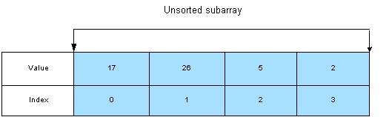
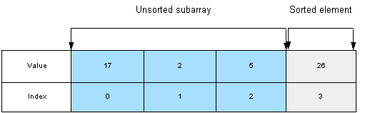
Selection Sort Example
In the beginning, the entire array is the unsorted subarray:
We swap the largest element with the last element:

Slide 49
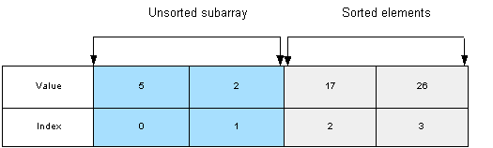
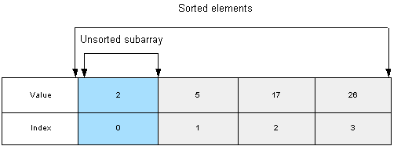
Selection Sort Example (continued)
Again, we swap the largest element and the last element:
When there is only one unsorted element, the array is completely sorted:

Slide 50
Swapping Values
To swap two values, we define a temporary variable to hold the value of one of the elements, so that we don't lose that value during the swap.
To swap elements a and b:
  define a temporary variable, temp
  assign element a to temp.
  assign element b to element a.
  assign temp to element b.

Slide 51
Swapping Example
This code will swap elements 33 and 82 in the int array array:
int temp;
temp = array[3];
array[3] = array[6];
array[6] = temp;
See Example 8.16 Sorter.java
and Example 8.17 SelectionSortClient.java
Value | … | 33 | … | 82 | …
Index | … | 3 | … | 6 | …
33
temp
Value | … | 82 | … | 82 | …
Index | … | 3 | … | 6 | …
Value | … | 82 | … | 33 | …
Index | … | 3 | … | 6 | …

Slide 52
Selection Sort Code
int temp;//temporary location for swap
int max; //index of max value in subarray
for ( int i = 0; i < array.length - 1; i++ )
{
max = indexOfLargestElement( array,
array.length - i );
// swap array[max] and
// array[array.length - i - 1]
temp = array[max];
array[max] = array[array.length - i - 1];
array[array.length - i - 1] = temp;
}

Slide 53
Insertion Sort
The basic approach to an Insertion Sort is to sort elements much like a card player arranges the cards in sorted order in his or her hand.
The player inserts cards one at a time so that the cards on the left side of the hand are sorted at all times; the cards on the right side of the hand have not been inserted into the sorted part of the hand.

Slide 54
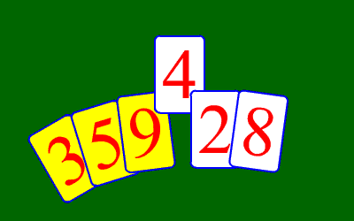
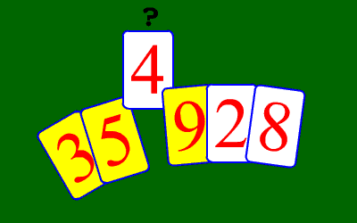
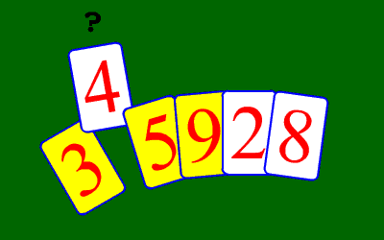
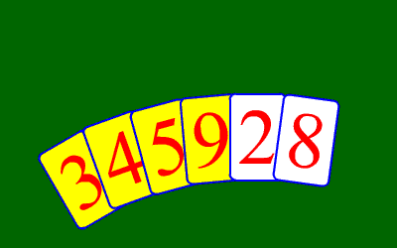
Insertion Sort
The yellow cards are sorted and
the white cards are not. To insert the 4,
we compare it to the 9.
4 is smaller, so we shift 9 to the right.
We compare the 4 to the 5.
4 is smaller, so we shift 5 to the right.
We compare the 4 to the 3.
4 is larger, so we insert 4 into the
correct slot.

Slide 55
Insertion Sort Algorithm
Insertion Sort uses a double loop.
Outer Loop : executes n - 1 times and iterates through the array elements from indexes 1 through n - 1. If the variable i represents the counter of the outer loop, the array can be thought of as made of three parts:
  a sorted subarray (although the elements may not be in their final position yet) from index 0 to i - 1,
  the array element (at index i ) that we are currently inserting,
  a subarray (from index i + 1 to n - 1) of elements that have not yet been inserted.
At each iteration of the outer loop, we insert the current array element at its proper place within the sorted subarray.

Slide 56
Insertion Sort Algorithm
The inner loop compares the current array element to the elements of the sorted array from right to left and shifts these elements to the right until it finds the proper insert location.
After all elements have been inserted, the array is sorted.

Slide 57
Insertion Sort Pseudocode
for i = 1 to last array index by 1
j = i
temp = element at index i
while ( j != 0 and value of current element is
greater than value of element at index j - 1 )
shift element at index j - 1 to the right
decrement j by 1
assign current element value (stored in temp)
to element at index j

Slide 58
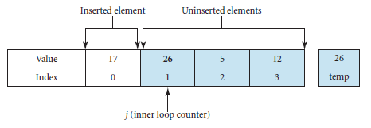
Insertion Sort Example
At the beginning, the array is:
The first element of the array, 17, is automatically in the
correct position when we consider the subarray as
consisting of that element only.
The value of the outer loop counter (i) is 1, and we will now
insert the second array element, 26, into the left subarray. First, we save the value of the element to be inserted by
storing it in temp.

Slide 59
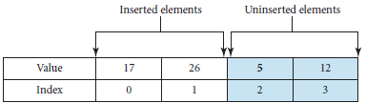
Insertion Sort Example (con’t)
We compare elements 26 and 17. Since 26 is larger than 17, we exit the inner loop.
We then assign the value of the current element, 26, stored in temp, to the element at index j = 1; in this case, there is no change to the array. The value 26 has been inserted.

Slide 60
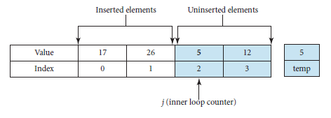
Insertion Sort Example (con’t)
The outer loop counter (i) is incremented, and its value is 2.
We will now insert the third array element, 5, into the left subarray. We start by saving the value 5 in temp.
The value of the inner loop counter ( j ) is set to the value of the outer loop counter (i ), i.e. 2.

Slide 61
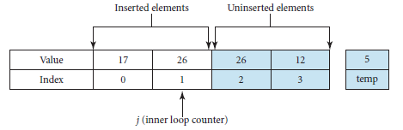
Insertion Sort Example (con’t)
We compare the current element, 5, stored in temp, and 26 (index j - 1 = 1).
Since 5 is smaller than 26, we shift 26 to the right and decrement j by 1; j now has the value 1.

Slide 62
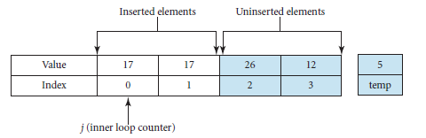
Insertion Sort Example (con’t)
We then compare the current element, 5, stored in temp, and 17 (index j - 1 = 0).
Since 5 is smaller than 17, we shift 17 to the right and decrement j by 1; j now has the value 0.

Slide 63
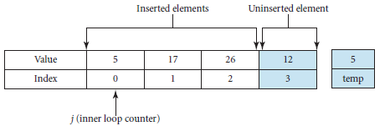
Insertion Sort Example (con’t)
Since j is 0, we exit the inner loop and assign the value of the current element, 5, stored in temp, to the array element at index j = 0.
The value 5 has now been inserted.

Slide 64
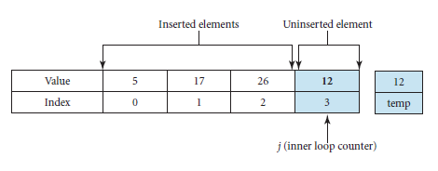
Insertion Sort Example (con’t)
The outer loop counter (i) is incremented, and its value is 3.
We will now insert the fourth array element, 12, into the left subarray. We start by saving 12 in temp.
The value of the inner loop counter ( j ) is set to the value of the outer loop counter (i ), i.e. 3.

Slide 65
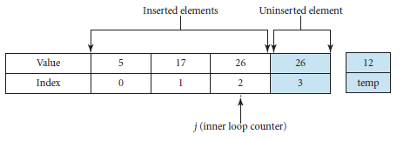
Insertion Sort Example (con’t)
We compare the current element, 12, stored in temp, and 26 (index j - 1 = 2). Since 12 is smaller than 26, we shift 26 to the right and decrement j by 1; j now has the value 2.

Slide 66
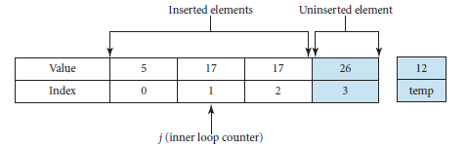
Insertion Sort Example (con’t)
We then compare the current element, 12, stored in temp, and 17 (index j - 1 = 1).
Since 12 is smaller than 17, we shift 17 to the right and decrement j by 1; j now has the value 1.

Slide 67
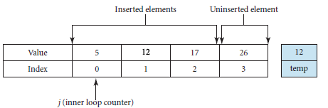
Insertion Sort Example (con’t)
We then compare the current element, 12, stored in temp, and 5 (index j - 1 = 0).
Since 12 is larger than 5, we store the value of temp in the current element and decrement j by 1; j now has the value 0.

Slide 68
Insertion Sort Example (con’t)
The outer loop counter (i) is incremented, and its value is 4, which causes the outer loop to terminate.
All the elements have been inserted; the array is now sorted..

Slide 69
Insertion Sort Code
int j, temp;
for ( int i = 1; i < array.length; i++ )
{
j = i;
temp = array[i];
while ( j != 0 && array[j - 1] > temp )
{
array[j] = array[j - 1];
j--;
}
array[j] = temp;
}
See Example 8.18 Sorter.java
and Example 8.19 InsertionSortClient.java

Slide 70
Sorting Arrays of Objects
In arrays of objects, the array elements are object references.
Thus, to sort an array of objects, we need to sort the data of the objects.
Usually, one of the instance variables of the object acts as a sort key.
  For example, in an email object, the sort key might be the date received.

Slide 71
Example
Insertion sort code to sort an array of Auto objects using model as the sort key:
Auto temp;
int j;
for ( int i = 1; i < arr.length; i++ )
{
j = i;
temp = arr[i];
while ( j != 0
&& ( temp.getModel( ) ).compareTo(
arr[j - 1].getModel( ) ) < 0 )
{
arr[j] = arr[j - 1];
j--;
} // end while loop
arr[j] = temp;
} // end for loop

Slide 72
Sequential Search of a Sorted Array
When the array is sorted, we can implement a more efficient algorithm for a sequential search.
If the search key is not in the array, we can detect that condition when we find a value that is higher than the search key.
All elements past that position will be greater than the value of that element, and therefore, greater than the search key.

Slide 73
Sequential Search of a Sorted Array
public int indexOfWinner( int key )
{
for ( int i = 0; i < winners.length
&& winners[i] <= key; i++ )
{
if ( winners[i] == key )
return i;
}
return –1; // end of array reached without
// finding key or
// an element larger than
// the key was found
}

Slide 74
Binary Search
A Binary Search is like the "Guess a Number" game.
To guess a number between 1 and 100, we start with 50 (halfway between 1 and 100).
  If we learn that the number is greater than 50, we immediately know the number is not 1 - 50.
  If we learn that the number is less than 50, we immediately know the number is not 50 - 100.
We keep guessing the number that is in the middle of the remaining numbers (eliminating half the remaining numbers) until we find the number.

Slide 75
Binary Search
The "Guess a Number" approach works because
1 - 100 are a "sorted" set of numbers.
To use a Binary Search, the array must be sorted.
Our Binary Search will attempt to find a search key in an array that is sorted in ascending order.
  If the search key is found, we return the index of the element with that value.
  If the search key is not found, we return -1.

Slide 76
The Binary Search Algorithm
We begin by comparing the middle element of the array and the search key.
  If they are equal, we found the search key and return the index of the middle element.
  If the middle element's value is greater than the search key, then the search key cannot be found in elements with higher array indexes. So, we continue our search in the left half of the array.
  If the middle element's value is less than the search key, then the search key cannot be found in elements with lower array indexes. So, we continue our search in the right half of the array.

Slide 77
The Binary Search Algorithm (con't)
As we keep searching, the subarray to search keeps shrinking in size. In fact, the size of the subarray to search is cut at least in half at every iteration.
If the search key is not in the array, the subarray to search will eventually become empty. At that point, we know that we will not find our search key in the array, and we return -1.

Slide 78

Example of a Binary Search
We will search for the value 7 in this sorted array:
To begin, we find the index of the center element, which is 8, and we compare our search key (7) to the value 45.

Slide 79

Binary Search Example (con't)
Because 7 is less than 45, we eliminate all array elements higher than our current middle element and consider elements 0 through 7 the new subarray to search.
The index of the center element is now 3, so we compare 7 to the value 8.

Slide 80

Binary Search Example (con't)
Because 7 is less than 8, we eliminate all array elements higher than our current middle element (3) and make elements 0 through 2 the new subarray to search.
The index of the center element is now 1, so we compare 7 to the value 6.

Slide 81

Binary Search: Finding the Search Key
Because 7 is greater than 6, we eliminate array elements lower than our current middle element (1) and make element 2 the new subarray to search.
The value of element 2 matches the search key, so our search is successful and we return the index 2.

Slide 82
Binary Search Example 2
This time, we search for a value not found in the array, 34. Again, we start with the entire array and find the index of the middle element, which is 8.
We compare our search key (34) with the value 45.

Slide 83
Binary Search Example 2 (con't)
Because 34 is less than 45, we eliminate array elements higher than our current middle element and consider elements 0 through 7 the new subarray to search.
The index of the center element is now 3, so we compare 34 to the value 8.

Slide 84

Binary Search Example 2 (con't)
Because 34 is greater than 8, we eliminate array elements lower than our current middle element and consider elements 4 through 7 the new subarray to search.
The index of the center element is now 5, so we compare 34 to the value 15.

Slide 85

Binary Search Example 2 (con't)
Again, we eliminate array elements lower than our current middle element and make elements 6 and 7 the new subarray to search.
The index of the center element is now 6, so we compare 34 to the value 22.

Slide 86

Binary Search 2: Search Key Not Found
Next, we eliminate array elements lower than our current middle element and make element 7 the new subarray to search.
We compare 34 to the value 36, and attempt to eliminate the higher subarray, which leaves an empty subarray. We have determined that 34 is not in the array.
We return -1 to indicate an unsuccessful search.

Slide 87
Binary Search Code
public int binarySearch( int [] array, int key )
{
int start = 0, end = array.length - 1;
while ( end >= start )
{
int middle = ( start + end ) / 2;
if ( array[middle] == key )
return middle; // key found
else if ( array[middle] > key )
end = middle - 1; // search left
else
start = middle + 1; // search right
}
return -1; // key not found
}

Slide 88
Using Arrays as Counters
To count multiple items, we can use an array of integers.
  Each array element is a counter.
Example: we want to throw a die and count the number of times each side is rolled.
  We set up an array of 6 integer counters, initialized to 0.
  For each roll, we increment the appropriate counter, using ( roll - 1 ) as the index of the array element to increment.

Slide 89
Example Code
// instantiate array of counters
int [] rollCount = new int [6];
Die d1 = new Die( );
// roll the die NUMBER_OF_ROLLS times
for ( int i = 1; i <= NUMBER_OF_ROLLS; i++ )
{
// roll the die
int myRoll = d1.roll( ); // returns 1 - 6
// increment the corresponding counter
rollCount[myRoll - 1]++;
}
See Examples 8.22 Die.java, 8.23 DieCount.java

Slide 90
Another Approach
Our algorithm is not ideal, however.
  we need to subtract 1 from the index in order to increment the counter.
  we need to add 1 to the index to print the outcome.
A better approach would be to create an array with seven elements. Then
  we can use elements 1 through 6 as the counters for the rolls 1 through 6.
  the index and the roll number will be the same.

Slide 91
Revised Code
// instantiate array of counters
int [] rollCount = new int [7];
Die d1 = new Die( );
// roll the die NUMBER_OF_ROLLS times
for ( int i = 1; i <= NUMBER_OF_ROLLS; i++ )
{
// roll the die
int myRoll = d1.roll( );
// increment the corresponding counter
rollCount[myRoll]++;
}
See Example 8.24 DieCount2.java

Slide 92
Variable Number of Arguments
Sometimes, the number of arguments to be sent to a method cannot be determined until run time. For example, you may have a method that validates inputs for other methods. The number of inputs may not be known until run time and may vary from one method call to the next.
In these cases, we can use a feature in the Java language named varargs.

Slide 93
Syntax for varargs
The method header specifies that it accepts a variable number of arguments by putting three dots immediately after the data type of the last parameter.
The syntax is the following:
accessModifier returnType methodName(
(0 to many parameters,)
dataType... lastParameter )
Note: there is no space between the data type and the three dots and the varargs parameter must be the last parameter

Slide 94
Managing varargs
The client can send the method a single argument, several arguments, an array of arguments, or no arguments.
For example, with this method API:
public void foo( int n, String... names)
The client could call the method any of the following ways:
obj.foo( number );
obj.foo( number, "Joan" );
obj.foo( number, "Joan", "Joe" );
String [] namesArray = { "Joan", "Joe" };
obj.foo( number, namesArray );

Slide 95
Managing varargs
When the method starts executing, the varargs parameter is available to the method as if the client had passed the arguments as an array. Thus, the method treats the parameter as an array.
See Example 8.24 Seller.java
Example 8.25 SellerRatings.java

